Slide 1
Case Study of How Actuaries Use R
Mark Chisholm
mark.chisholm@xlcatlin.com
R in Insurance 2015

Slide 2

Agenda
Background
Multivariate modelling
Interactive data visualisation
Enriching data sets
Lessons learned

Slide 3

Background
The specialty insurance & reinsurance market offer protection for unique risks

Slide 4
Multivariate Modelling

Slide 5
Multivariate Modelling
Many actuaries use MS Excel to evaluate multiple predictors using one-way tables

Slide 6

Multivariate Modelling
Obtaining an initial fit using multivariate modelling techniques only requires a few lines of code
  Generalised linear models
  Techniques less widely used in insurance
    Discriminant analysis (MASS package)
    Random forests (randomForest package)
Actuarial exams emphasise that one-way techniques can mask exposure correlations

Slide 7
Multivariate Modelling
It is worth exploring different ideas
  Test different response variables and models
    Claim frequencies or severities
    Probability that there will be a claim notified
    Probability that the incurred loss ratio will exceed a benchmark
  Test different predictors
    Territory, premium band, revenues, deductible/excess, limit, etc.
    Experiment with including or not including different actuarial assumptions such as trend, loss development, on-leveling, etc.
    Use external data to supplement your predictors (more on this later)

Slide 8

Multivariate Modelling
If you have already prepared your data in Excel, why not load it into R and perform a multivariate analysis?
You could:
  Save the table you wish to analyse as a tab-delimited text file
  Make use of packages such as as RExcel or XLConnect

Slide 9
Multivariate Modelling
An illustrative example of using logistic regression

Slide 10
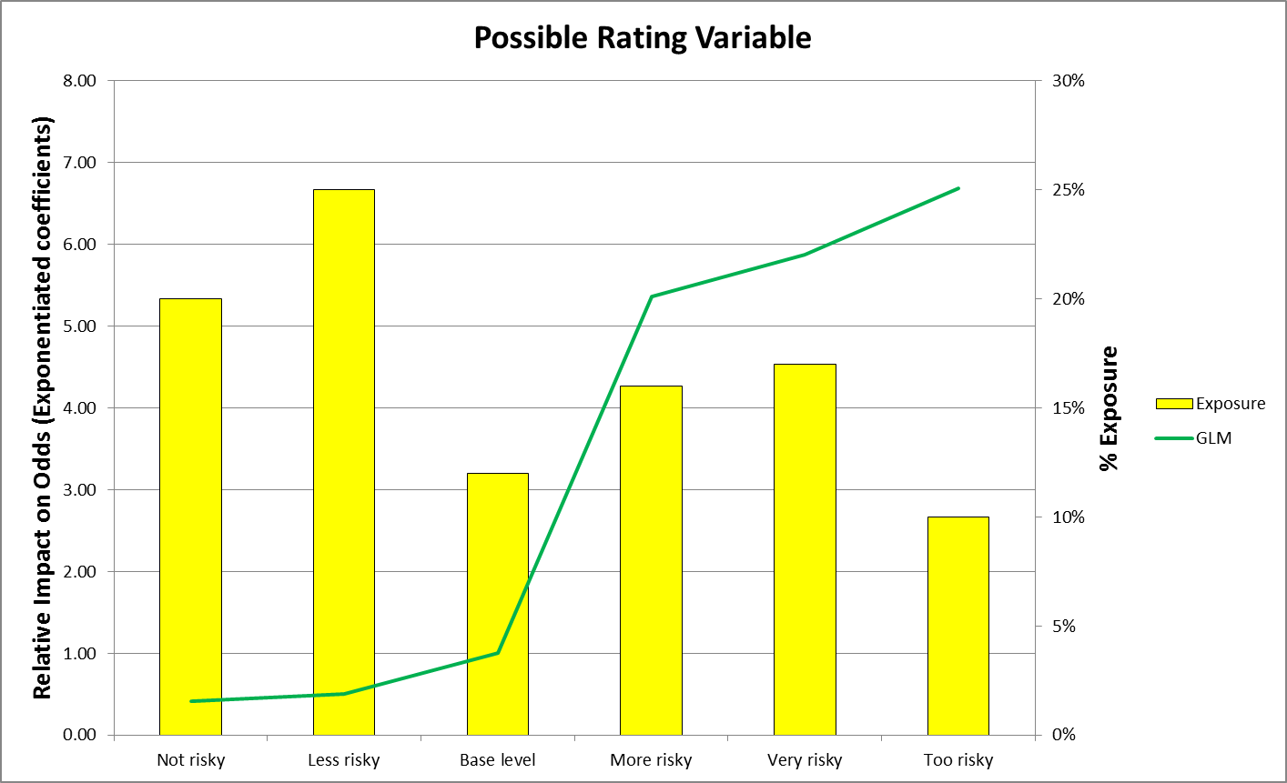
Multivariate Modelling
An illustrative example of using logistic regression
Notes:
Possible interpretation: “The model suggests that the odds that a policy in the ‘very risky’ category will have at least one notification are 6x higher than the base case, all else being equal.”

Slide 11
Interactive Data Visualisation

Slide 12
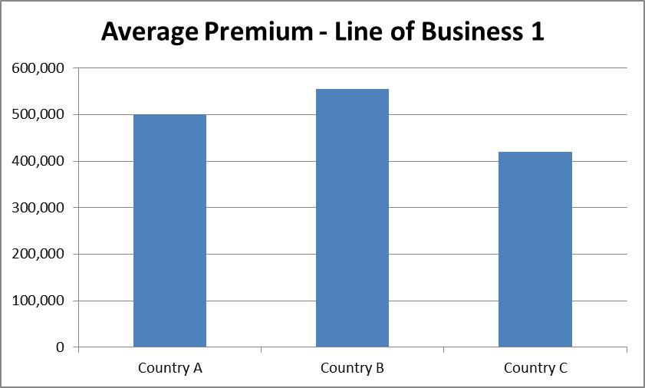
Interactive Data Visualisation
Information is often shared through standardised reports
  Hardcopy printout, pdf, MS Word doc, etc.

Slide 13

Interactive Data Visualisation
The shiny package lets you make interactive web sites very quickly
Knowledge of JavaScript, HTML, and other web programming languages is not required
Supports the use of ggplot2, googleVis, etc. for graphics

Slide 14
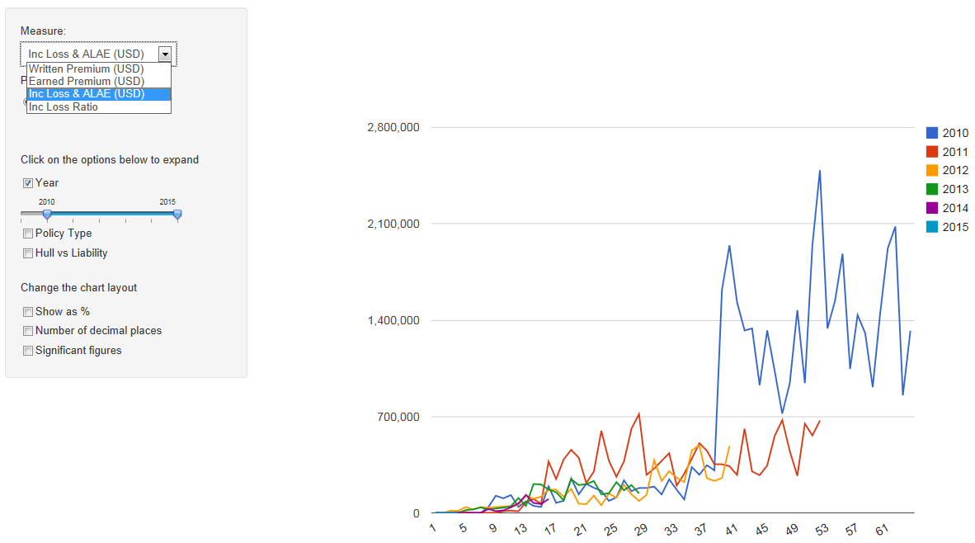
Interactive Data Visualisation
Monthly loss development using shiny and googleVis

Slide 15





Interactive Data Visualisation
Drop-down lists
Buttons
Check boxes
Radio buttons
Free form entry
Sliders

Slide 16
Enriching Data Sets

Slide 17

Enriching Data Sets
Internal sources of data are often the first place to look when trying to understand the characteristics of policyholders
  Deductible/attachment point
  Territory
  Premium charged
  Perhaps various coding specific to the class of business

Slide 18

Enriching Data Sets
External data sources should also be considered
Underwriters may be able to point you to web sites with relevant data
  Demographic, geologic, economic, atmospheric, etc.
  Consider the raster package for working with geospatial data kept in raster format (.bil files)

Slide 19
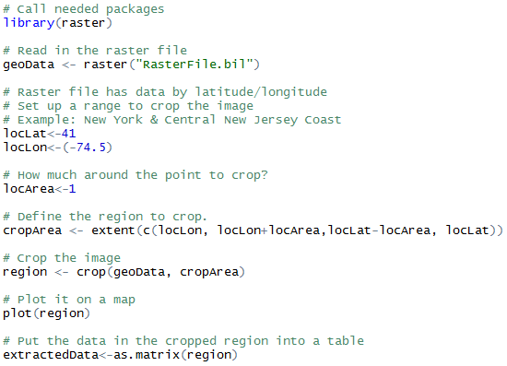
Enriching Data Sets
Working with raster images

Slide 20
Lessons Learned

Slide 21

Lessons Learned
Common concerns
  “I’m not a programmer, I don’t have the time to learn R”
  Focus on one bite-sized task to do in R and do the rest using the tools you are comfortable with
  Repeatable tasks
    Monthly MI with nice charts
    Fitting statistical models

Slide 22

Lessons Learned
Common concerns
  “I don’t have enough data to do multivariate analysis”
  If you have enough data to evaluate multiple variables on a one-way basis you have enough to try multivariate approaches

Slide 23
Lessons Learned
Common concerns
  “I downloaded R but it has a complex user interface and is difficult to use”
  Use a search engine to find an “IDE for R” – this kind of tool makes it much easier to write source code

Slide 24

Lessons Learned
A helpful resource for actuaries:
Puts statistical ideas into plain English, which is ideal for practitioners
Has labs with sample R code, which makes it easy to apply the techniques to your company’s data sets
Available for free from author’s web site

Slide 25
Questions?

