Slide 1
Pricing of MAXL treaties
Conference R in Insurance – 29/06/2015
Indra LOLJEEH – Technical Advisor Analytics at QBE Re – li@qbere.com

Slide 2
Agenda
Reminder about reinsurance treaties
MAXL treaties
Pricing of MAXL treaties
Structure of the pricing program
Conclusion

Slide 3
Agenda
Reminder about reinsurance treaties
Reinsurance basic treaties
Aggregate clauses in reinsurance
MAXL treaties
Pricing of MAXL treaties
Structure of the pricing program
Conclusion

Slide 4
Traditional reinsurance
Quota share (QS)
Stop loss
(SL)
Surplus
(SP)
Excess of loss
(XL)

Slide 5
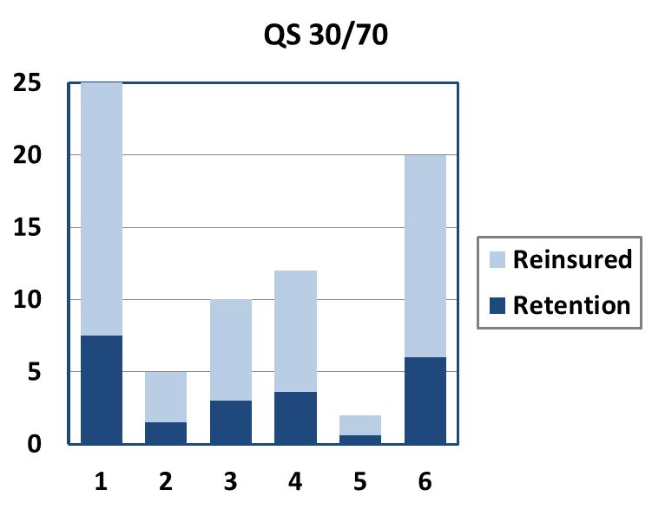
Quota-Share
Quota share (QS)
Stop loss
(SL)
Surplus
(SP)
Excess of loss
(XL)
Cession rate: $α_{i}=α$for all risks $i$

Slide 6
Surplus
Quota share (QS)
Stop loss
(SL)
Surplus
(SP)
Excess of loss
(XL)
Cession rate: $α_{i}≠α$for all risks $i$
$α_{i}=\max\left(0,1−\frac{R}{SI_{i}}\right)$ where $R$ is called the surplus line

Slide 7
Excess of loss
Quota share (QS)
Stop loss
(SL)
Surplus
(SP)
Excess of loss
(XL)
Notation: C xs D
$X$original claim amount
$X^{Reins}=\min\left(C,\max\left(0,X−D\right)\right)$
$X^{Ret}=X−X^{Reins}$

Slide 8
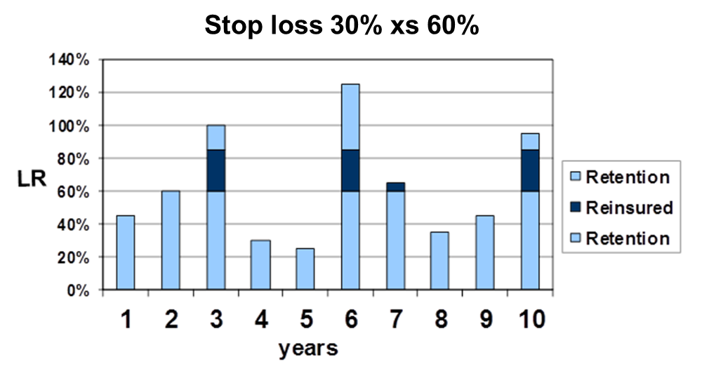

Stop loss
Quota share (QS)
Stop loss
(SL)
Surplus
(SP)
Excess of loss
(XL)
Notation: C xs D
$S=X_{1}+ …+X_{N}$
$S^{Reins}=\min\left(C,\max\left(0,S−D\right)\right)$
$S^{Ret}=S−S^{Reins}$

Slide 9
Aggregate clauses in reinsurance
AAD: Aggregate Annual Deductible
AAL: Aggregate Annual Limit
Link with Stop-Loss treaties
➔ These elements are the basis of most currently existing reinsurance structures

Slide 10
Agenda
Reminder about reinsurance treaties
MAXL treaties
Concept of MAXL treaties
Illustration/Example
Pricing of MAXL treaties
Structure of the pricing program
Conclusion

Slide 11
Concept of MAXL treaties
Multiline:
Reinsurance treaty covering several lines of business at the same time
Common protection for several portfolios
Aggregate
Structure that contains aggregate clauses (MAAD/MAAL)
These clauses are applied on a global level
eXcess of Loss
Non-proportional structure
Protection against medium/high claims

Slide 12
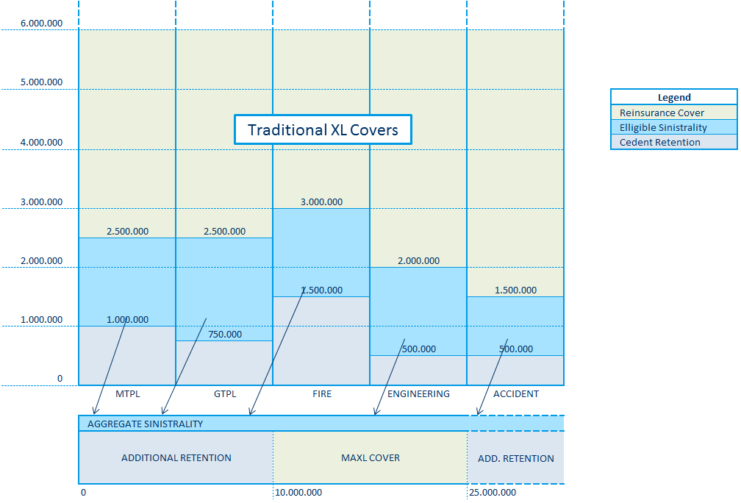
MAXL Example

Slide 13
MAXL Example
Eligible Claim Activity
Interior Priority

Slide 14
Advantages of such structures
Improved protection against medium sized claims
Towards frequency
Towards changes in legislation
Protection of insurer’s global results
Can cover several lines of business at the same time
Cheaper than lower XL cover
Optimization of the reinsurance structure (Solvency II)

Slide 15
Agenda
Reminder about reinsurance treaties
MAXL treaties
Pricing of MAXL treaties
Collective risk model / Monte-Carlo methods
Problems inherent to MAXL treaties
Correlations
Lines of business (ST/LT)
Time
What R brought to us
Structure of the pricing program
Conclusion

Slide 16
Theory behind the pricing of MAXL
Collective Risk model: Independency between frequency and severity
Determination of the loss distribution of the eligible layers
Determination of the frequency distributions
Aggregation of the loss distributions
Use of copulas
Dependency structure between the lines of business ?
Dependency above thresholds ?
Long tail vs. Short tail businesses ?
Use of Monte-Carlo simulations
Simulation for each line of business
Aggregation to obtain aggregate loss distribution

Slide 17
Problems inherent to such methods
Time-consuming process
➔ Need for an efficient software
Many underlying structures possible
➔ Need for program flexibility
Still some developments needed for the copula part
➔ Need for a modular program
Difficult to take account of some distributions (CAT Softwares)

Slide 18
Problems inherent to such methods
Time-consuming process
➔ Need for an efficient software
Many underlying structures possible
➔ Need for program flexibility
Still some developments needed for the copula part
➔ Need for a modular program
Difficult to take account of some distributions (CAT Softwares)
R is our savior !!!

Slide 19
Agenda
Reminder about reinsurance treaties
MAXL treaties
Pricing of MAXL treaties
Structure of the pricing program
Conclusion

Slide 20
Structure of the pricing program

Slide 21
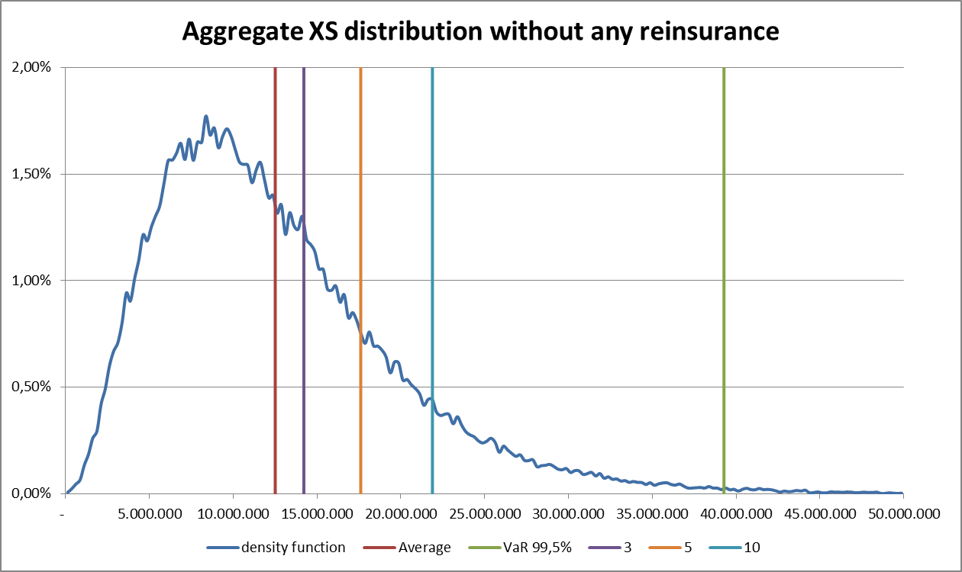
Global distribution

Slide 22
Agenda
Reminder about reinsurance treaties
MAXL treaties
Pricing of MAXL treaties
Structure of the pricing program
Conclusion

Slide 23
Advantages of R in our case
Ideal for simulation based tools
Simplification of the audit process
Program easy to modify and improve
Packages already existing
Possibility for further analysis on data
Graphs
Sensitivity analysis
Reporting

Slide 24
Questions?

