Slide 1
Acquiring External Data With R
Mark Chisholm
11 July 2016

Slide 2
Agenda
The data landscape
Using R to access external data
Illustrative example
Conclusion

Slide 3
The Data Landscape

Slide 4
The Data Landscape
Underwriters want information that will help them answer questions such as:
How can we offer relevant insurance products for our clients?
How much in premium would we need to charge in order to break even in the long run?
How many years will it take for all claims arising from a group of policies to settle?
Actuaries and data scientists that work closely with underwriters can help answer these questions

Slide 5
The Data Landscape
Data can be limited in specialty insurance
Policies might not be homogenous
Claims can arise from unforeseen risks
May not capture enough attributes about the contract, insured, claim, etc.
Lack of data: “not enough rows” (small sample size)
“not enough columns” (not enough variables)
“not enough granularity” (not enough levels)

Slide 6
The Data Landscape
Some possible solutions to the issue of lack of data
Capture selected information going forward in corporate systems
Assemble the information from other internal sources
Purchase data from vendors
Acquire the data from sources on the internet

Slide 7
The Data Landscape
Acquire the data from sources on the internet
Some web sites that are relevant to insurance will provide data under their terms & conditions
In some cases it could be relatively easy to download (for example, an FTP site)
Others may provide data, but will require navigating a web interface
Some web sites are easier to grab information from than others

Slide 8
The Data Landscape
Acquire the data from sources on the internet
Numerous tools available in many languages which can extract external data
Packages to accomplish these tasks are available in R

Slide 9
Using R to Access External Data

Slide 10
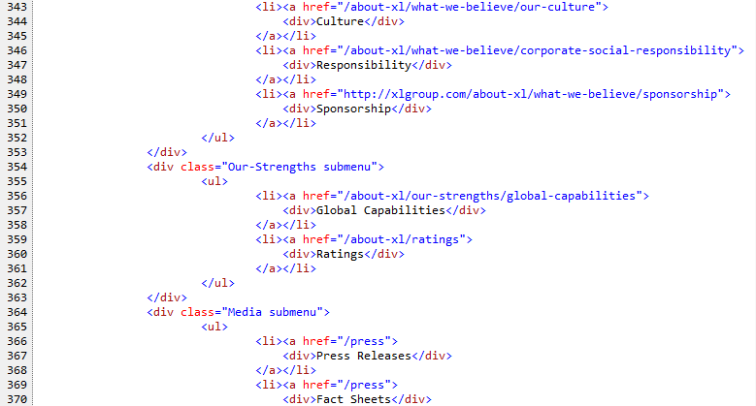
Using R to Access External Data
What makes up a web site?

Slide 11
Using R to Access External Data
Primarily make use of these tools:
Selector Gadget helps identify elements to extract in a web page
rvest then extracts the elements, and R can then be used to further process the data or make it available in shiny
RSelenium is a useful tool for manipulating web pages with more complex layouts

Slide 12
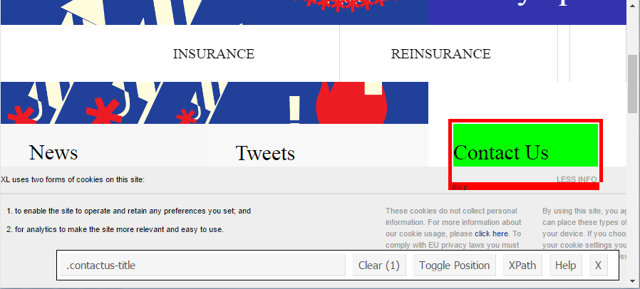
Using R to Access External Data
How can you identify elements in a web page?
Selector Gadget
https://cran.r-project.org/web/packages/rvest/vignettes/selectorgadget.html

Slide 13
Using R to Access External Data
Common web browser tasks using rvest and RSelenium
Navigating to a web page
Follow links
Extract information from a table
Extract information from free text
Manipulate pages with “complex” user interfaces

Slide 14
Using R to Access External Data
Common web browser tasks using rvest and RSelenium
Navigating to a web page
Follow links

Slide 15
Using R to Access External Data
Common web browser tasks using rvest and RSelenium
Extract information from a table
Extract information from free text

Slide 16
Using R to Access External Data
Common web browser tasks using rvest and RSelenium
Manipulate pages with “complex” user interfaces
Selenium is a useful tool for creating instances of a web browser
Primarily used to test UIs, but can be useful in extracting data
http://www.seleniumhq.org/download/

Slide 17
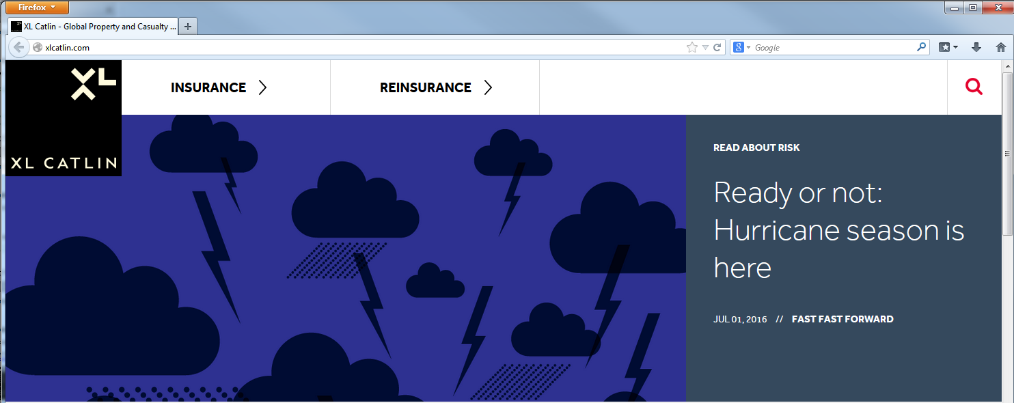
Using R to Access External Data
Common web browser tasks using rvest and RSelenium
Once a page is loaded, Selenium can send keystrokes and mouse clicks

Slide 18
Illustrative Example

Slide 19
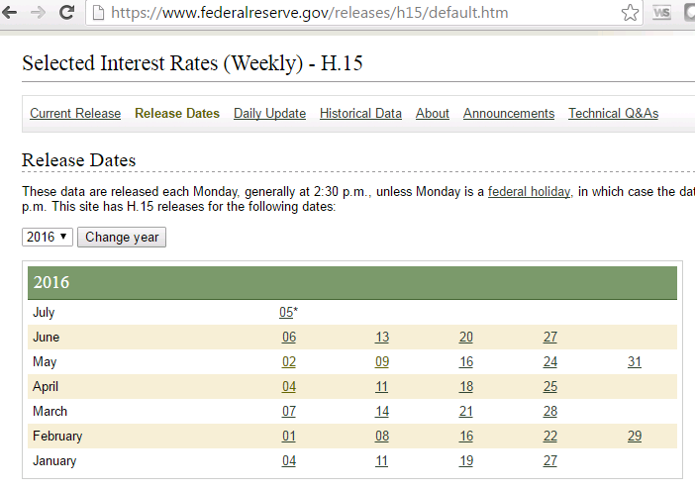
Illustrative Example
Interest rate data

Slide 20
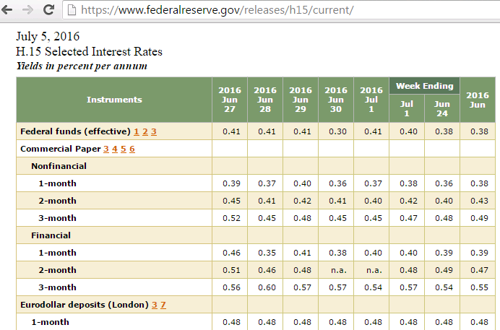
Illustrative Example
Interest rate data

Slide 21
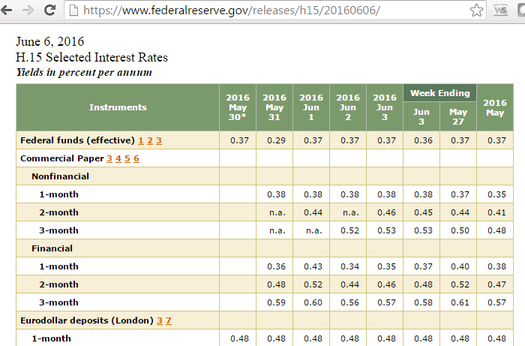
Illustrative Example
Interest rate data

Slide 22
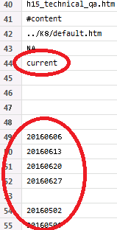
Illustrative Example
Following the underlying links

Slide 23
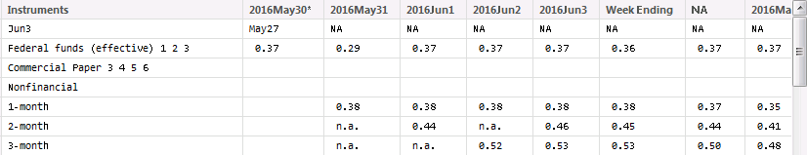
Illustrative Example
Extract the relevant table

Slide 24
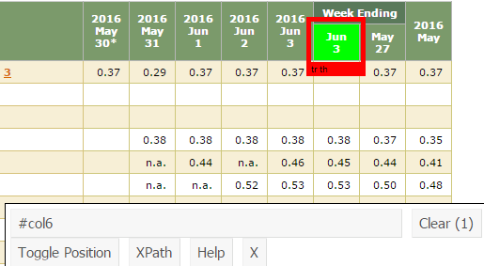
Illustrative Example
Problematic column header

Slide 25
Illustrative Example
Next steps
Perform data manipulation, then cycle through the remaining links and repeat, binding the tables from each iteration together
NOTE! The Federal Reserve provides much simpler ways to access data. This example was intended to show one way that R packages could be used to access data on a web page

Slide 26
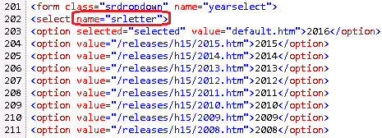
Illustrative Example
One way RSelenium could be used

Slide 27
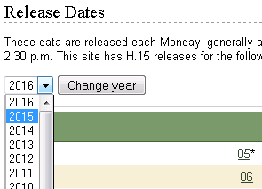
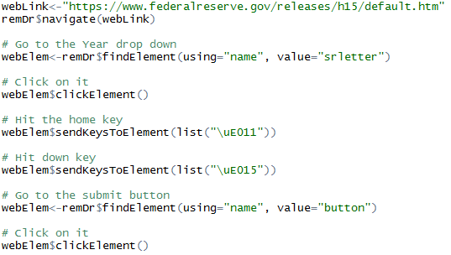
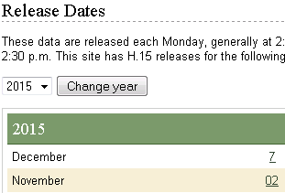
Illustrative Example
One way RSelenium could be used

Slide 28
Conclusion

Slide 29
Conclusion
Technical perspective
The functionality for navigating to web sites and extracting tables, links and free text using rvest provides useful building blocks
Identify items using Selector Gadget, which can then be used in rvest
Data on web sites which render interactively might be accessible with RSelenium
Find patterns in the way a web site arranges information
The illustrative example showed one approach, but there are other ways to extract data

Slide 30
Conclusion
Final thoughts
External data can help the underwriters you work for make better pricing decisions
Even if that data can’t be linked to policyholders/claims, it could be presented in a shiny app so that underwriting can consider it
Always follow a publisher’s terms & conditions and be a considerate user

Slide 31
Questions?

