Slide 1
Investigating the correlation between month of birth and diagnosis of specific diseases
Ben Rickayzen, David Smith, Leonel Rodrigues Lopes Junior
Cass Business School

Slide 2
Background
There have been a number of studies looking at the links between month of birth and specific diseases
In particular, there are arguments that diabetes is driven by diet and sunlight (via vitamin D) and that these factors may be important both pre-birth and in the baby’s earliest months
Often hard to get hold of monthly birth data
As part of a bigger project on healthcare costs, we have access to the data of a Brazilian healthcare provider which includes the month of birth
We thus set out to investigate whether there was a link between month of birth and likelihood of developing diabetes

Slide 3
Dataset
Unimed-BH healthcare database
  For each policyholder (who has had a healthcare plan in last three years) we have:
    Date of birth
    gender
    ID number of each beneficiary
Unimed-BH healthcare support programmes
  For each policyholder we have the above data plus
    Healthcare program that the beneficiary was registered in - Asthma, Cardiovascular Diseases, Chronic Kidney Disease, Chronic Obstructive Pulmonary Disease, Diabetes, Mental Health and Nephrolithiasis

Slide 4
Testing the correlation
If there is no correlation there should be a uniform number of members with birthdays from each month
However
  Not all months are the same length
  Uniformity of all births throughout the calendar year is unlikely
We therefore need to investigate the distribution of birthdays throughout the calendar year and derive factors that allow us to take the observed membership of the clubs and turn them into ‘uniform’ data

Slide 5
Investigating the birth rates for different months
Month | Days of the month | Females
 |  | Number of Births (observed) | % of Births (observed) | Births per day | Number of births if each month had the same number of days | % births if each month had the same number of days
Jan | 31 | 167,401 | 8.55% | 5,400 | 164,251 | 8.39%
Feb | 28 | 153,395 | 7.84% | 5,478 | 166,634 | 8.51%
Mar | 31 | 172,286 | 8.80% | 5,558 | 169,044 | 8.63%
Apr | 30 | 166,029 | 8.48% | 5,534 | 168,335 | 8.60%
May | 31 | 171,535 | 8.76% | 5,533 | 168,307 | 8.60%
Jun | 30 | 161,945 | 8.27% | 5,398 | 164,194 | 8.39%
Jul | 31 | 164,978 | 8.43% | 5,322 | 161,874 | 8.27%
Aug | 31 | 160,671 | 8.21% | 5,183 | 157,648 | 8.05%
Sep | 30 | 163,694 | 8.36% | 5,456 | 165,968 | 8.48%
Oct | 31 | 163,388 | 8.35% | 5,271 | 160,313 | 8.19%
Nov | 30 | 154,939 | 7.92% | 5,165 | 157,091 | 8.02%
Dec | 31 | 156,975 | 8.02% | 5,064 | 154,021 | 7.87%
Total | 365 | 1,957,236 | 100.00% | 5,362 | 1,957,680 | 100.00%

Slide 6
Investigating the birth rates for different months
Month | Days of the month | Males
 |  | Number of Births (observed) | % of Births (observed) | Births per day | Number of births if each month had the same number of days | % births if each month had the same number of days
Jan | 31 | 143,397 | 8.36% | 4,626 | 140,699 | 8.20%
Feb | 28 | 134,868 | 7.86% | 4,817 | 146,508 | 8.54%
Mar | 31 | 151,823 | 8.85% | 4,898 | 148,966 | 8.68%
Apr | 30 | 145,501 | 8.48% | 4,850 | 147,522 | 8.60%
May | 31 | 148,831 | 8.68% | 4,801 | 146,030 | 8.51%
Jun | 30 | 142,721 | 8.32% | 4,757 | 144,703 | 8.43%
Jul | 31 | 144,610 | 8.43% | 4,665 | 141,889 | 8.27%
Aug | 31 | 140,910 | 8.21% | 4,545 | 138,258 | 8.06%
Sep | 30 | 144,598 | 8.43% | 4,820 | 146,606 | 8.54%
Oct | 31 | 143,227 | 8.35% | 4,620 | 140,532 | 8.19%
Nov | 30 | 135,722 | 7.91% | 4,524 | 137,607 | 8.02%
Dec | 31 | 139,390 | 8.12% | 4,496 | 136,767 | 7.97%
Total | 365 | 1,715,598 | 100.00% | 4,700 | 1,716,088 | 100.00%

Slide 7
Adjustments to make the observations uniform
Month | Female
 | Uniform | Obs. | Ratio (U/O)
Jan | 163,103 | 167,401 | 0.974
Feb | 163,103 | 153,395 | 1.063
Mar | 163,103 | 172,286 | 0.947
Apr | 163,103 | 166,029 | 0.982
May | 163,103 | 171,535 | 0.951
Jun | 163,103 | 161,945 | 1.007
Jul | 163,103 | 164,978 | 0.989
Aug | 163,103 | 160,671 | 1.015
Sep | 163,103 | 163,694 | 0.996
Oct | 163,103 | 163,388 | 0.998
Nov | 163,103 | 154,939 | 1.053
Dec | 163,103 | 156,975 | 1.039
Total | 1,957,236 | 1,957,236
Month | Male
 | Uniform | Obs. | Ratio (U/O)
Jan | 142,967 | 143,397 | 0.997
Feb | 142,967 | 134,868 | 1.060
Mar | 142,967 | 151,823 | 0.942
Apr | 142,967 | 145,501 | 0.983
May | 142,967 | 148,831 | 0.961
Jun | 142,967 | 142,721 | 1.002
Jul | 142,967 | 144,610 | 0.989
Aug | 142,967 | 140,910 | 1.015
Sep | 142,967 | 144,598 | 0.989
Oct | 142,967 | 143,227 | 0.998
Nov | 142,967 | 135,722 | 1.053
Dec | 142,967 | 139,390 | 1.026
Total | 1,715,598 | 1,715,598

Slide 8
Observations for members of the diabetes club
Month | Females |  |  |  | Males
 | Observed births |  | Adjusted births |  | Observed births |  | Adjusted births
 | N | % | N | % | N | % | N | %
Jan | 690 | 7.99% | 672.28 | 7.78% | 517 | 8.41% | 515.45 | 8.39%
Feb | 680 | 7.87% | 723.04 | 8.37% | 448 | 7.29% | 474.90 | 7.73%
Mar | 708 | 8.20% | 670.26 | 7.76% | 553 | 9.00% | 520.74 | 8.48%
Apr | 771 | 8.93% | 757.41 | 8.76% | 491 | 7.99% | 482.45 | 7.85%
May | 713 | 8.26% | 677.95 | 7.84% | 534 | 8.69% | 512.96 | 8.35%
Jun | 732 | 8.48% | 737.23 | 8.53% | 520 | 8.46% | 520.89 | 8.48%
Jul | 773 | 8.95% | 764.21 | 8.84% | 551 | 8.96% | 544.74 | 8.87%
Aug | 745 | 8.63% | 756.28 | 8.75% | 492 | 8.00% | 499.18 | 8.13%
Sep | 755 | 8.74% | 752.27 | 8.70% | 541 | 8.80% | 534.90 | 8.71%
Oct | 719 | 8.32% | 717.75 | 8.31% | 537 | 8.74% | 536.02 | 8.73%
Nov | 699 | 8.09% | 735.83 | 8.51% | 477 | 7.76% | 502.46 | 8.18%
Dec | 652 | 7.55% | 677.45 | 7.84% | 486 | 7.91% | 498.47 | 8.11%
Total | 8,637 | 100.00% | 8,641.98 | 100.00% | 6,147 | 100.00% | 6,143.16 | 100.00%

Slide 9
How to test?
The default test in the majority of the literature would be to carry out a chi-squared test for observed versus expected
However, this may not be the most appropriate when looking at seasonality
For example, we may have a very high number for March and a very low number for April which would mean the chi-squared fails
Or high values for March and September and low values for January and June again leading to a chi-squared fail
Or we may have slightly lower values for April to September and higher values for October to March which doesn’t trigger a chi-squared fail

Slide 10
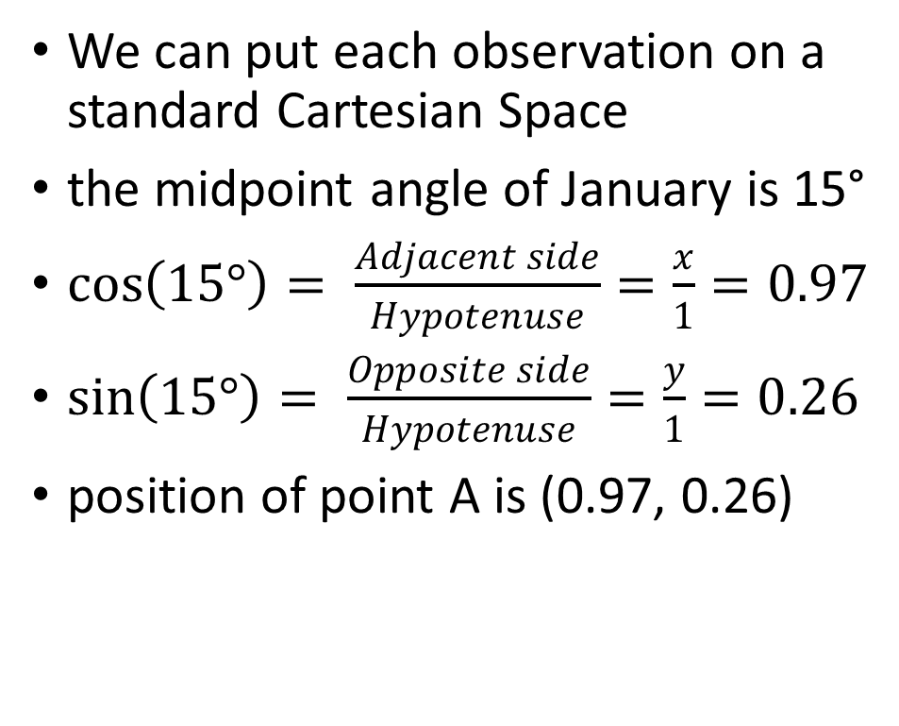
A better way?
We can put each observation on a standard Cartesian Space
the midpoint angle of January is 15°
$\cos\left(15°\right)= \frac{Adjacent side}{Hypotenuse}=\frac{x}{1}=0.97$
$\sin\left(15°\right)= \frac{Opposite side}{Hypotenuse}=\frac{y}{1}=0.26$
position of point A is (0.97, 0.26)

Slide 11
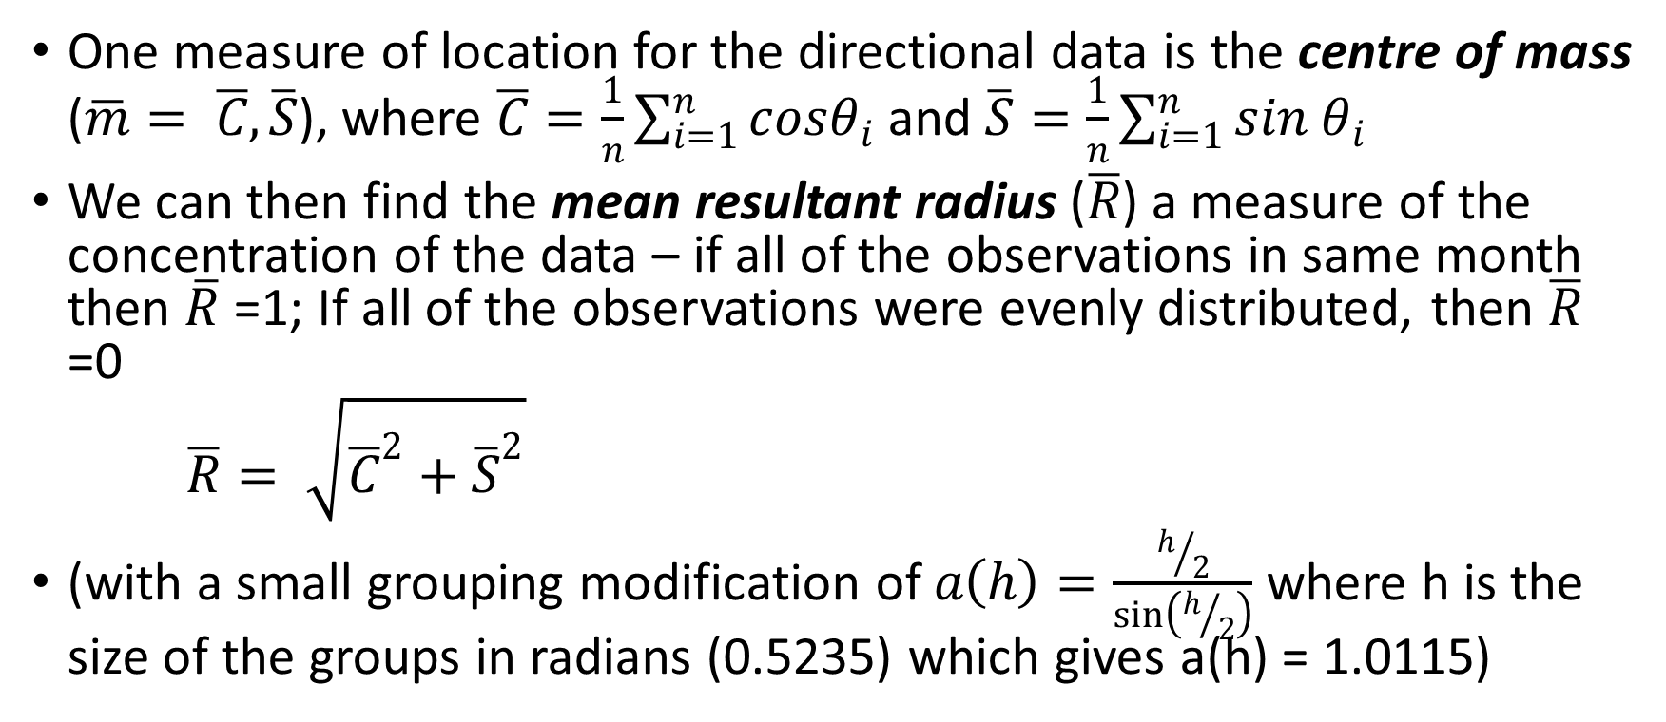
Test Statistics
One measure of location for the directional data is the centre of mass ($\overline{m}= \overline{C},\overline{S}$), where $\overline{C}=\frac{1}{n}\sum_{i=1}^{n}{cosθ_{i}}$ and $\overline{S}=\frac{1}{n}\sum_{i=1}^{n}{sin θ_{i}}$
We can then find the mean resultant radius ($\overline{R}$) a measure of the concentration of the data – if all of the observations in same month then $\overline{R}$ =1; If all of the observations were evenly distributed, then $\overline{R}$ =0
$\overline{R}= \sqrt{{\overline{C}}^{2}+{\overline{S}}^{2}}$
(with a small grouping modification of $a\left(h\right)=\frac{h/2}{\sin\left(h/2\right)}$ where h is the size of the groups in radians (0.5235) which gives a(h) = 1.0115)

Slide 12

Test Statistics
We can also calculate the mean direction ($\overline{θ}$), which will give us, in this scenario, the month where the higher diabetes incidence is focused

Slide 13
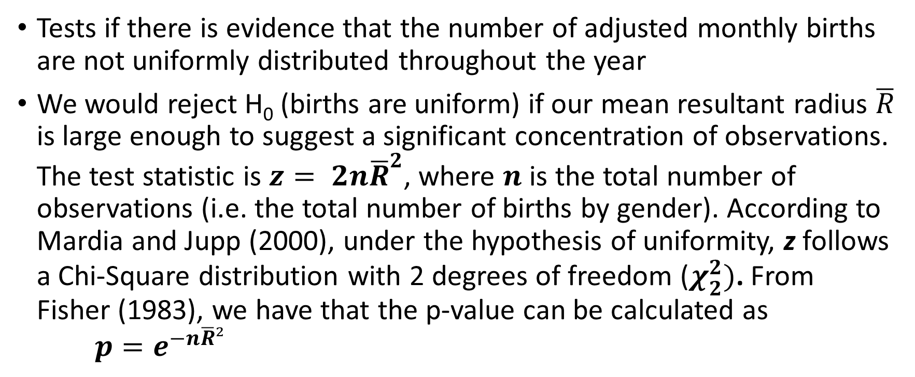
The Rayleigh Test
Tests if there is evidence that the number of adjusted monthly births are not uniformly distributed throughout the year
We would reject H₀ (births are uniform) if our mean resultant radius $\overline{R}$ is large enough to suggest a significant concentration of observations. The test statistic is $z= 2n{\overline{R}}^{2}$, where $n$ is the total number of observations (i.e. the total number of births by gender). According to Mardia and Jupp (2000), under the hypothesis of uniformity, z follows a Chi-Square distribution with 2 degrees of freedom ($χ_{2}^{2})$. From Fisher (1983), we have that the p-value can be calculated as $p=e^{−n\overline{R}²}$

Slide 14


Results
 | Diabetes
Statistics | Females | Males
n | 8637 | 6147
 | 0.0230 | 0.0165
 | 215.2845 | 230.0982
Z | 9.1670 | 3.3511
p-value | 0.0102 | 0.1872
We can see that there appears to be a significant result for females with a p-value close to 0.01
The mean direction is 215⁰ which translates to the month of August
Males have a similar direction but the p-value is not significant
$$\overline{R}$$
$$\overline{θ}$$

Slide 15
Graphical Representation
R allows us to easily create
a Rose Diagram

Slide 16


What about the other diseases…
As most of this data manipulating and testing can be done automatically in R using the circular package we can easily test the other diseases for evidence of monthly effects
 | Cardiovascular |  | Mental Health |  | Asthma
Statistics | Females | Males | Females | Males | Females | Males
n | 4278 | 3322 | 3504 | 1789 | 4914 | 4481
 | 0.0368 | 0.0113 | 0.0213 | 0.0584 | 0.0098 | 0.0190
 | 295.2571 | 331.9359 | 177.6938 | 41.8971 | 66.7812 | 115.8736
Z | 11.5873 | 0.8523 | 3.1897 | 12.2220 | 0.9520 | 3.2509
p-value | 0.0030 | 0.6530 | 0.2029 | 0.0022 | 0.6213 | 0.1968
$$\overline{R}$$
$$\overline{θ}$$

Slide 17


What about the other diseases…
 | Chronic kidney disease |  | COPD |  | Nephrolithiasis
Statistics | Females | Males | Females | Males | Females | Males
n | 632 | 663 | 360 | 436 | 47 | 30
 | 0.0111 | 0.0125 | 0.0713 | 0.0714 | 0.0585 | 0.0762
 | 172.3831 | 168.3168 | 303.1873 | 1.4649 | 247.6186 | 310.2424
Z | 0.1564 | 0.2079 | 3.6685 | 4.4581 | 3.0601 | 3.2828
p-value | 0.9248 | 0.9013 | 0.1597 | 0.1076 | 0.2165 | 0.1937
$$\overline{R}$$
$$\overline{θ}$$

Slide 18
Results
It would appear that we have found strong evidence that the month of birth affects females in terms of Cardiovascular with the focus on October
It would also appear that we have found strong evidence that the month of birth affects males in terms of Mental Health with the focus on February
These results are alongside our original result that we had strong evidence that the month of birth affects females in terms of diabetes with the focus on August

Slide 19
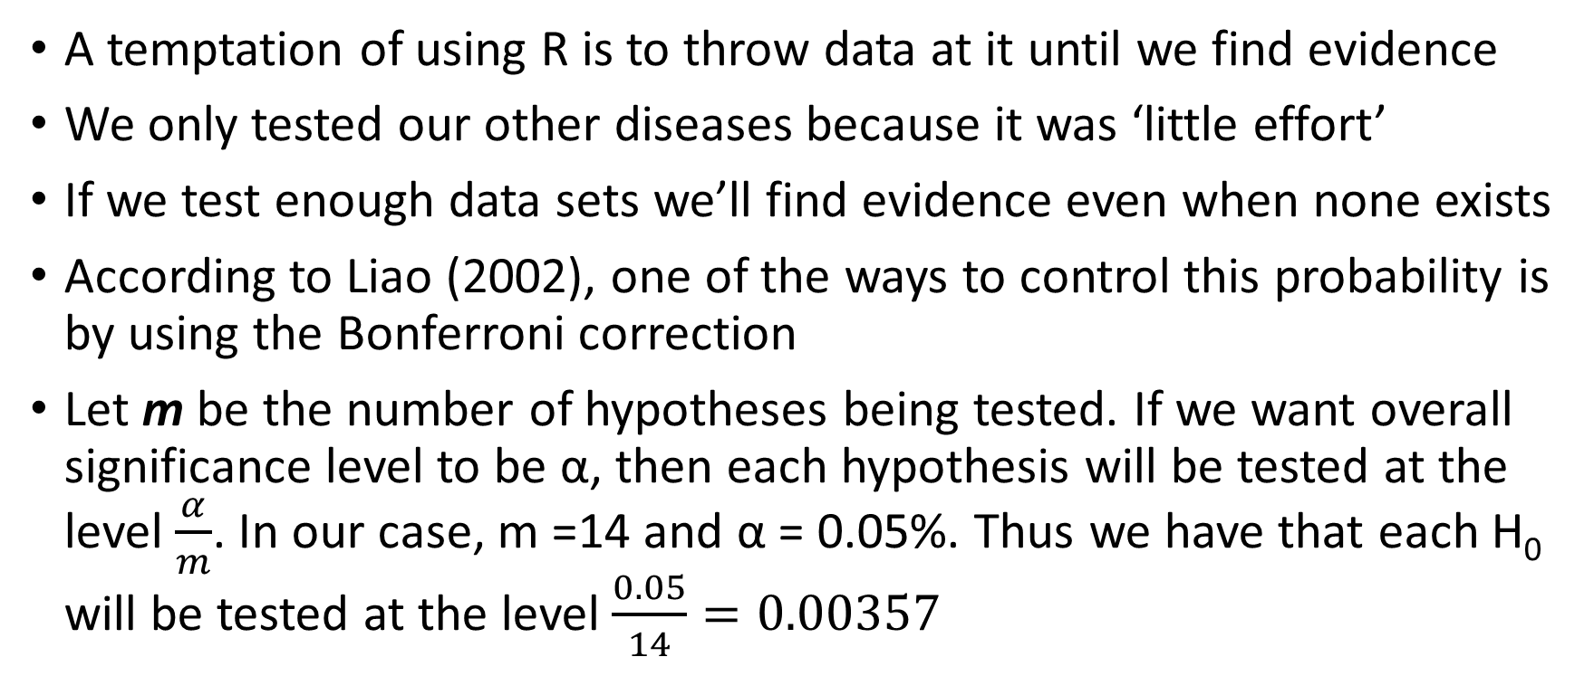
But may be we are fishing…
A temptation of using R is to throw data at it until we find evidence
We only tested our other diseases because it was ‘little effort’
If we test enough data sets we’ll find evidence even when none exists
According to Liao (2002), one of the ways to control this probability is by using the Bonferroni correction
Let m be the number of hypotheses being tested. If we want overall significance level to be α, then each hypothesis will be tested at the level $\frac{α}{m}$. In our case, m =14 and α = 0.05%. Thus we have that each H₀ will be tested at the level $\frac{0.05}{14}=0.00357$

Slide 20
Updated results
However, this does lead to the paradox that we would now no longer reject the diabetes hypothesis for females even though we would have kept it if we had only focused on diabetes…
…but we would still keep our other two rejection results
Though when we look at both male and female results together, diabetes is the one with the most consistent story i.e. the focus is in a similar month for both genders

