Slide 1
Data Scientist vs Actuary A Perspective using Shiny and HTMLWidgets
Richard Pugh
Chief Data Scientist @ Mango Solutions
Silver Director @ R Consortium
Co-Author “R in 24 Hours”
@richatmango
rich@mango-solutions.com

Slide 2
Over-Elaborate Agenda Slide
Who are Mango?
Background: The LIFE Conference
Agenda
The Data Science Radar
Shiny & HTMLWidgets
Rapturous Applause

Slide 3
Who are Mango?
Data Science Services
Analytic Infrastructure
R Training & Consulting
We ♥ R

Slide 6
Actuary ~ 63% Data Scientist ~ 37%

Slide 7
My Role …
Talking about Unicorns …

Slide 8
Data Science Radar
Communicator
Visualizer
Data Wrangler
Modeller
Programmer
Technologist

Slide 11
The HTMLWidgets Package
Allows us to use JavaScript visualization libraries from R
Embed widgets in R Markdown and Shiny
Choose existing, or develop new widgets
Created by Ramnath Vaidyanatha, Yihui Xie, JJ Allaire, Joe Cheng & Kenton Russell

Slide 12
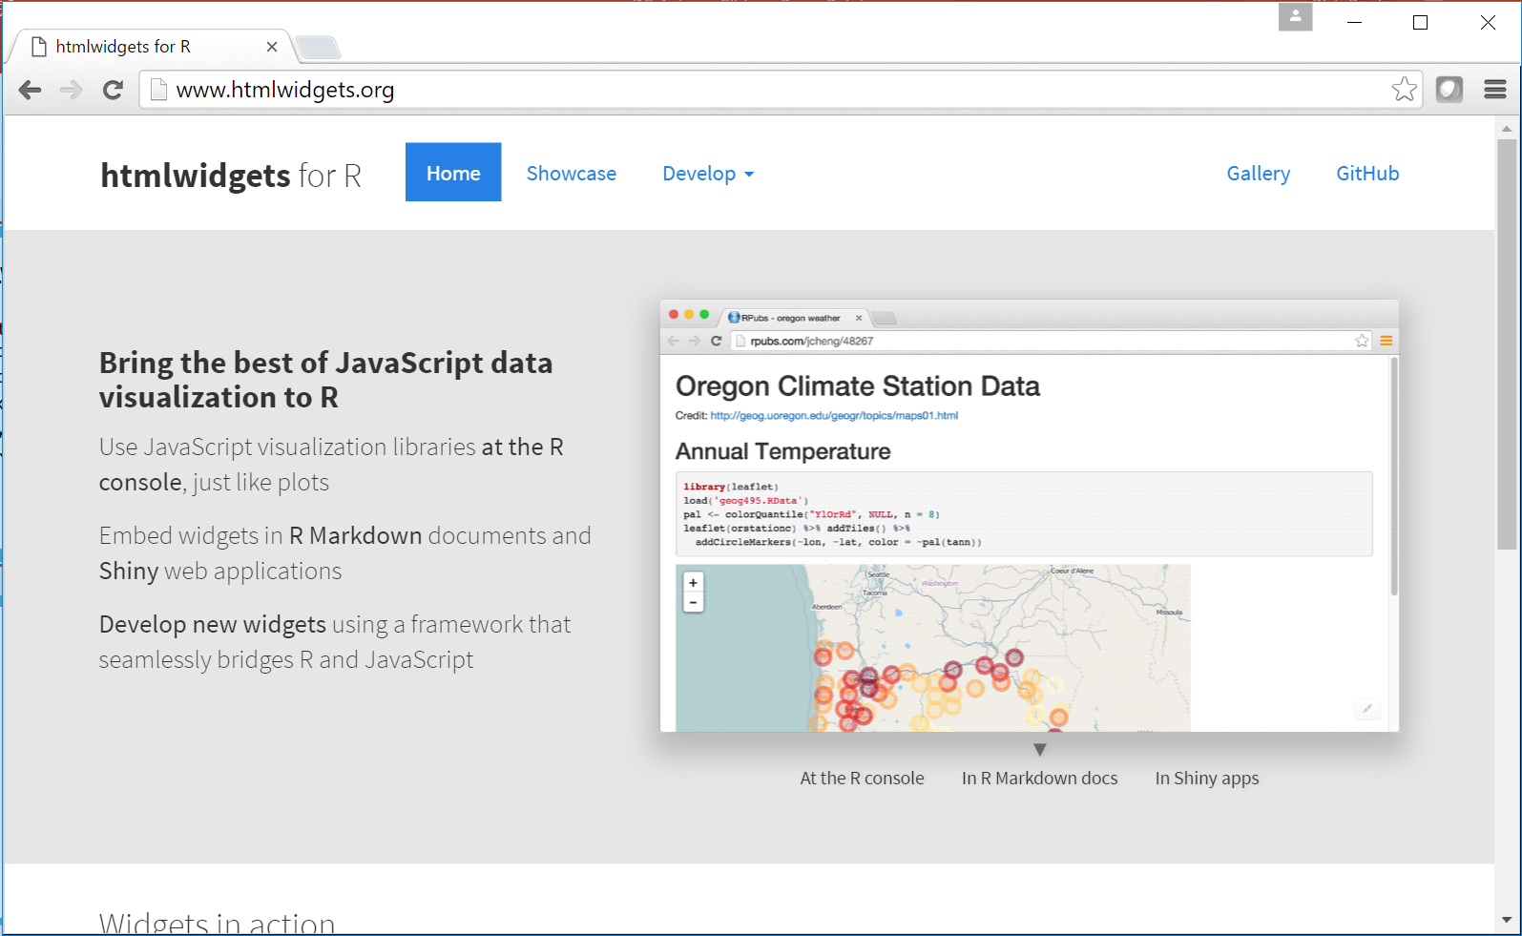

Slide 13
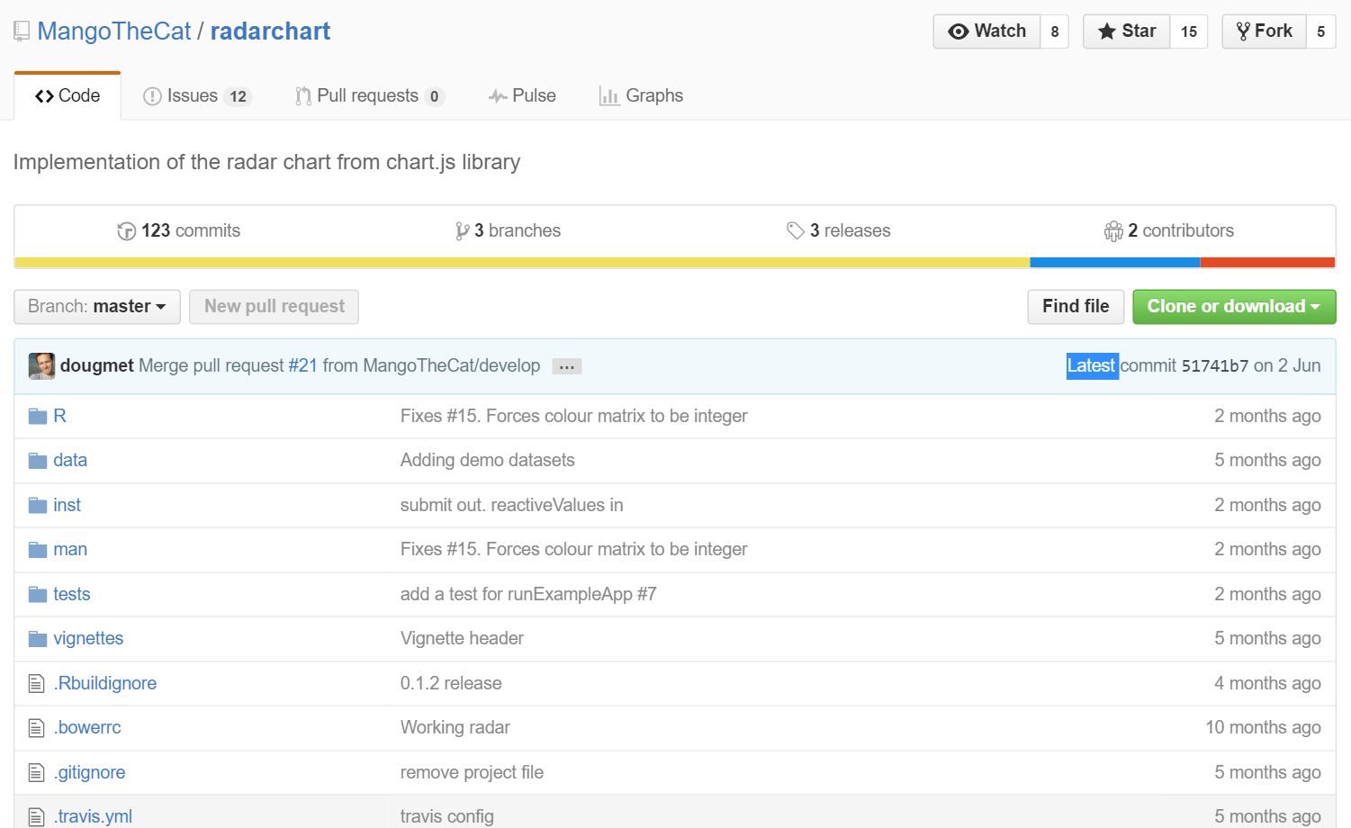
https://github.com/MangoTheCat/radarchart

Slide 14
An Actuary?
Communicator
Visualizer
Data Wrangler
Modeller
Programmer
Technologist

Slide 15
@RichAtMango rich@mango-solutions.com

Slide 16
Building a Widget from Bower.io
Find the widget you want
Create an R package
Run scaffoldWidget
Edit the R function and tweak the JavaScript!

