Slide 1
R, Shiny and the Oasis Loss Modelling Framework
Mark Pinkerton
mark.pinkerton@oasislmf.org

Slide 2
Oasis vision
Oasis tech stack
Oasis use of R and R-Shiny,
with a worked example

Slide 3
Oasis vision
To be the main “alternative” platform for the insurance sector, and the main platform for non-insurance catastrophe model use.
To be a focal point for community engagement and standards in the area of catastrophe modelling.
By being open and curating open source software, to enable a wide community to innovate and scale the world of catastrophe modelling.

Slide 4
Oasis membership
ClimateKIC
Lloyd’s
SCOR
XL Catlin
Validus
Ren Re
TigerRisk Partners
Cathedral
Novae
Zurich
Liberty
Aspen
Aon Benfield
Guy Carpenter
Willis
Partner Re
Allianz
Axis
Amlin
Tokio Millennium Re/Kiln
Suncorp
JLTRe
GenRe
Swiss Re
Beazley
Argo
Ark
Ascot
Barbican
Brit
Canopius
Chaucer
Hardy
Mitsui Sumitomo
QBE
R&Q
W R Berkley
XL
Axa
ANV
Ace
Markel
Hannover Re

Slide 6
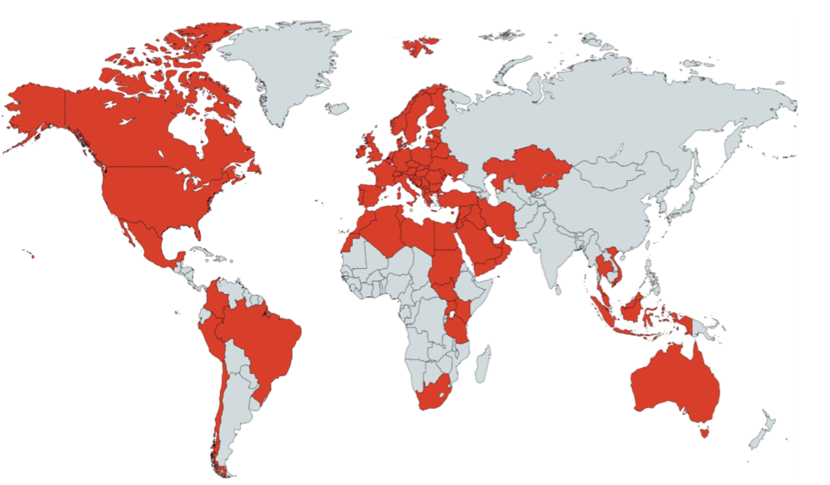
Oasis projected model coverage 2016
Over 70 models from 12 providers

Slide 7
Oasis vision
Oasis tech stack
Oasis use of R and R-Shiny,
with a worked example

Slide 8
Architectural goals
1. Configurable and pluggable
ability to support any model or calculation methodology
2. Range of deployment options
insurance enterprise systems through to academic model development or consulting projects
3. High performance
can run industrial strength model in acceptable times

Slide 9
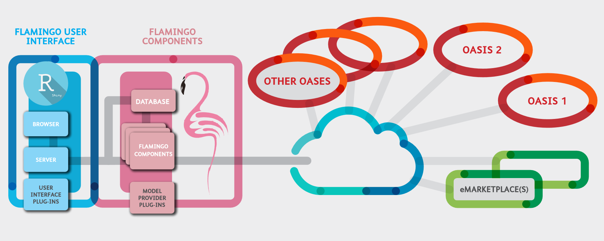
Oasis Eco-system

Slide 10
Oasis Technology Stack
User Interaction
Data engineering
Analytics
Data persistence
And others to come….

Slide 11
Oasis vision
Oasis tech stack
Oasis use of R and R-Shiny,
with a worked example

Slide 12
Use case 1 – analytic workstation
Model developers, power analysts
Direct invocation of Oasis components from R
Combine existing R code and expertise…
… with high performance analytics and industry standard methodologies
Oasis C++ components

Slide 13
Use case 2 – cat modelling platform
OASIS
Cat modellers, underwriters
Use R-Shiny web application, or interface with existing risk applications using Oasis API
Hosted platform this summer, for use by 10+ Lloyd’s managing agents, and in-house deployments at multiple (re)insurers

Slide 14
Login

Slide 15
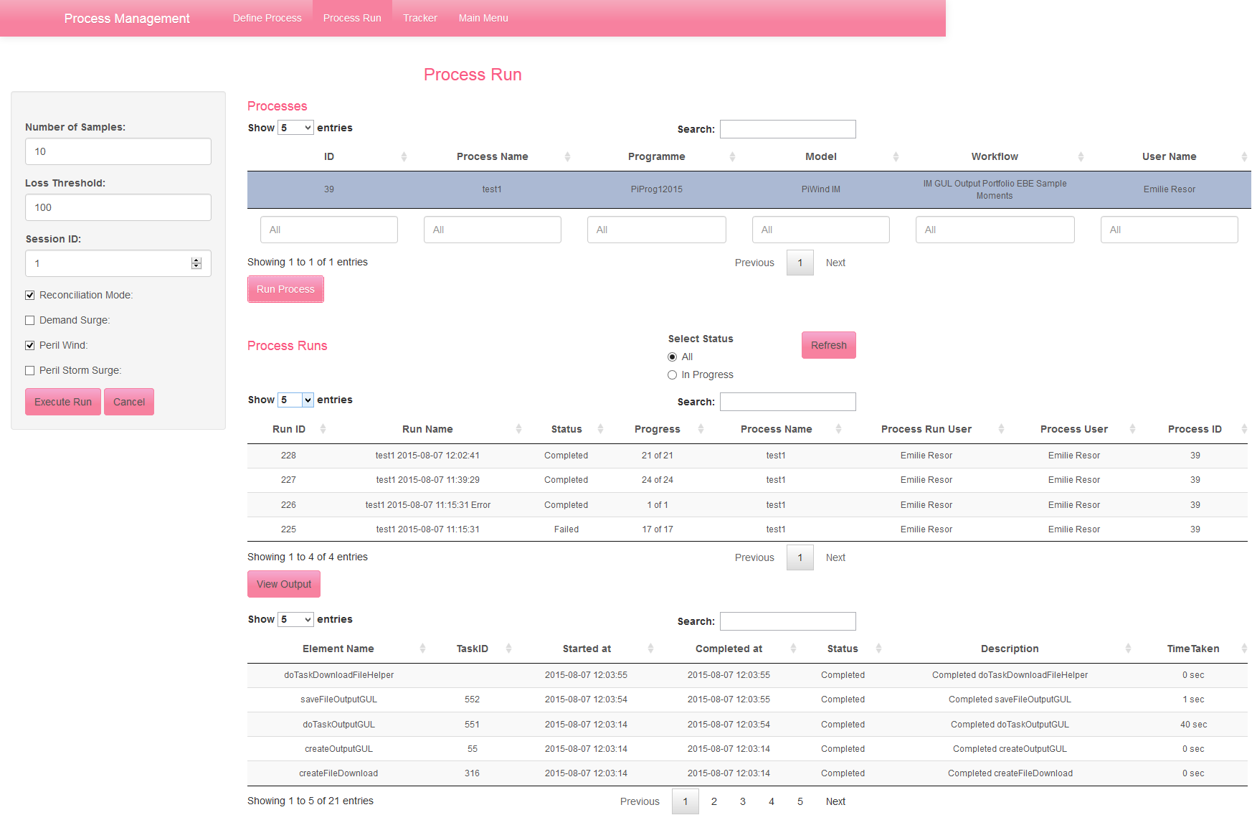
Execute Process Run

Slide 16
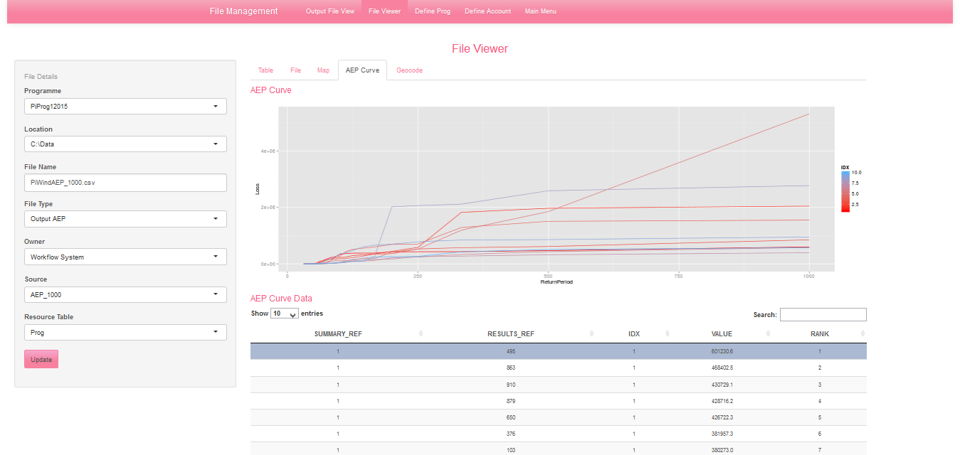
File Viewer - EP Curve

Slide 17
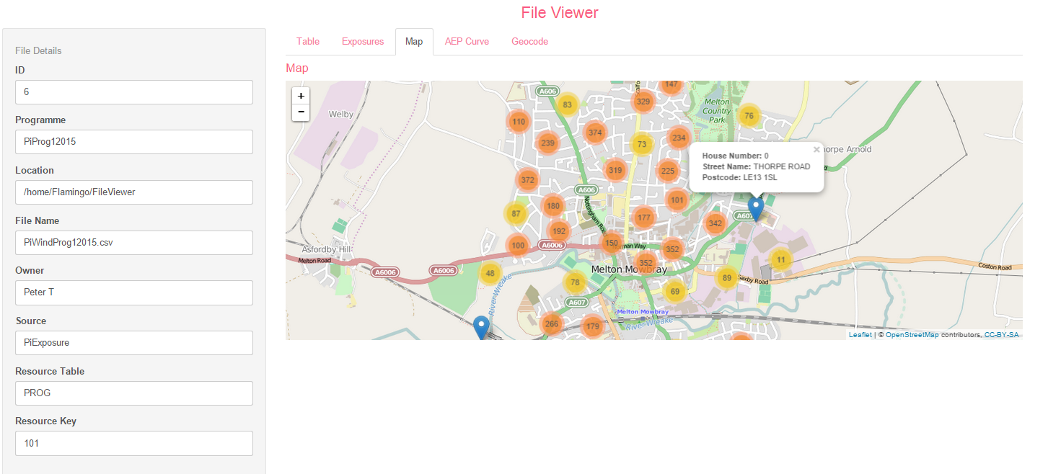
Output Example – map
Notes:
Geocoding, everything in blue comes back from geocoder.
Wheatsheaf – shows multi-modal behaviour
Illustrations only – but submit requests.
People who know R can write their own.

Slide 18
Shiny demo –background
Catastrophe models use an event catalogue to represent a particular peril
Much of the correlation in loss is captured in an event footprint
Uncertainty in the modelled losses can be categorized as:
Primary uncertainty
event selection and frequency
Secondary uncertainty
hazard and vulnerability uncertainty conditioned on a particular event
Parameter uncertainty

Slide 19
Shiny demo

Slide 20
Summary
Oasis vision
Main “alternative” platform for insurance, and main platform for non-insurance
Community engagement and standards catastrophe modelling
Using open source software to drive innovation and scale in the world of catastrophe modelling.
Oasis tech stack
Based on open technologies and frameworks
Hosted environment for Lloyd’s MAs this summer
Going open source in 2016
Oasis use of R and R-Shiny
R/Oasis integration for power analytics
R-shiny application for Oasis platform
Strong potential for expanded use of R in the cat modelling community

